Slide 1
Crowd System

Slide 2
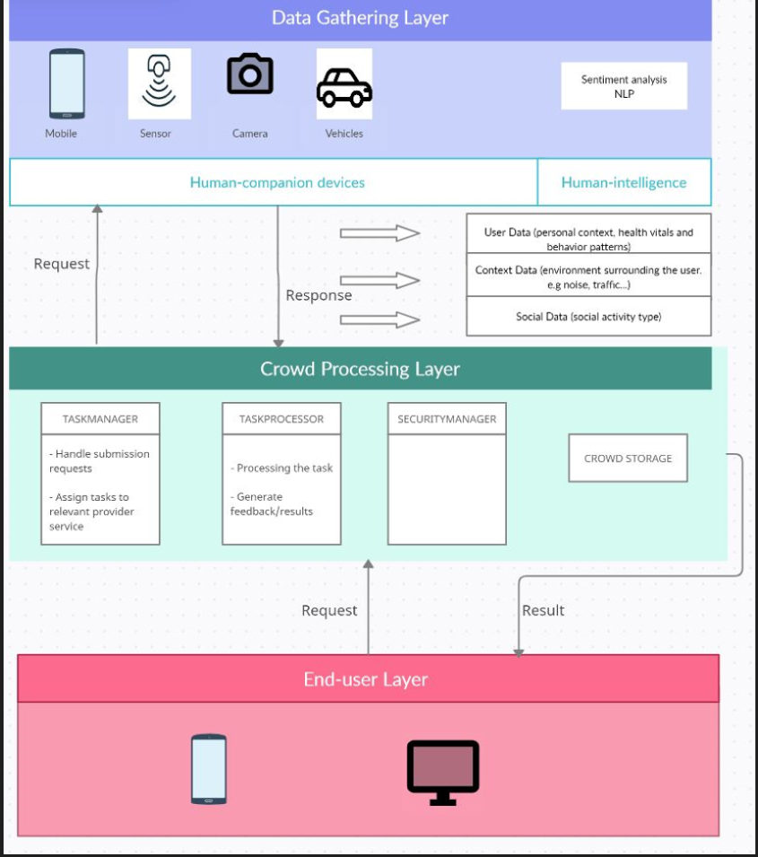
System overview

Slide 3
System Components
No | Component name | Component Type | Description
1 | ProviderService | Microservice | Provide activities to manage providers such as creating, inquiring, updating and deleting a provider
2 | OnDemandService | Microservice | Provide activities to manage customers such as creating, inquiring, updating and deleting a customer
3 | MonitoringService | Microservice | Monitor transactions and performance in the system to improve the matching mechanism
4 | CrowdService | Microservice | Match between providers and customers according to matching attributes
5 | JobManagerScheduler | Scheduler/Batch job | Pickup pending booking requests and pass these requests to MatchingService to process the next step
6 | ProviderDb | Database | Store provider information
7 | CustomrDb | Database | Store customer information
8 | CrowdDb | Database | Store setup filtering rules and crowd system transactions

Slide 4
Provider Service
Method name | HTTP METHOD | Endpoint | Description
createProvider | POST | /provider/ | Create a new provider
getProviderByRegionAndJobs | GET | /providers/ | Get all providers by a specific region (country -> state -> city) and jobs
updateProvider | PUT | /provider/ | Update an existing provider such as the provider locations, providers’ jobs
deleteProvider | DELETE | /provider/[providerCode] | Delete an existing provider

Slide 5
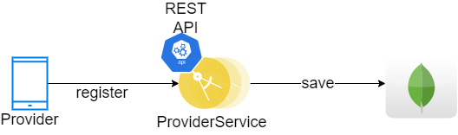
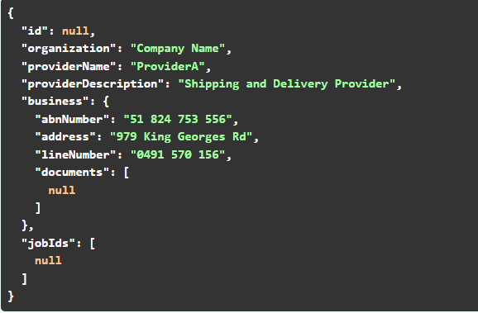
Provider Service API
Create a new provider
Endpoint: /providers/
The business object is dynamic depends on the service provider

Slide 6
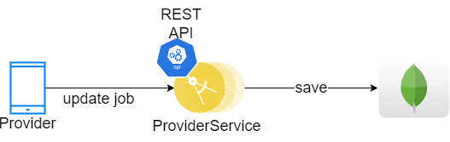
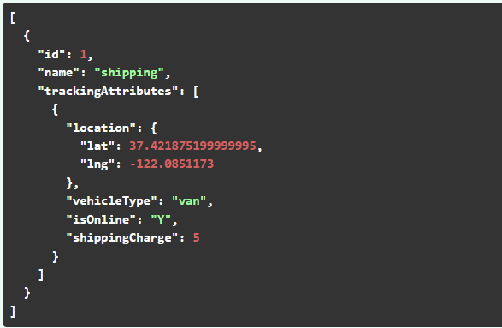
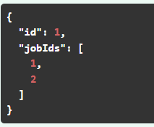
Provider Service API
Update an existing provider
Endpoint: /providers/jobs/update
The trackingAttributes auto populates accordingly to the job type

Slide 7
Customer Service
Method name | HTTP METHOD | Endpoint | Description
createCustomer | POST | /customers/ | Create a new customer
getCustomerById | GET | /customers/[customerId] | Retrieve a customer by Id
updateCustomer | PUT | /customers/ | Update an existing customer
deleteCustomer | DELETE | /customers/[customerId] | Delete an existing customer

Slide 8
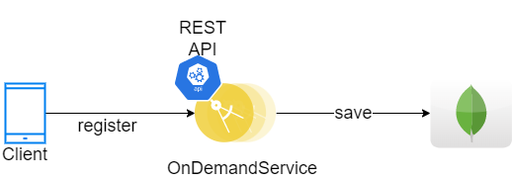
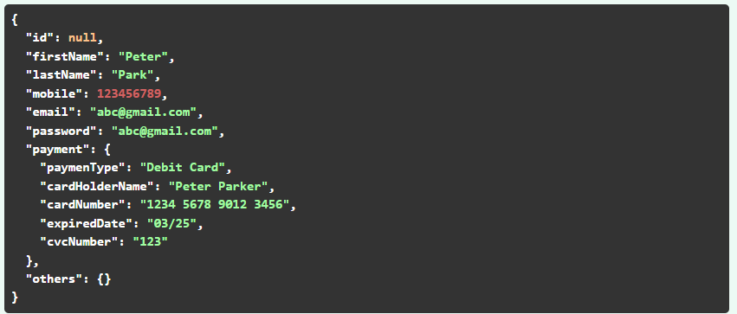
Customer Service API
Register a new customer
Endpoint: /customers/register

Slide 9
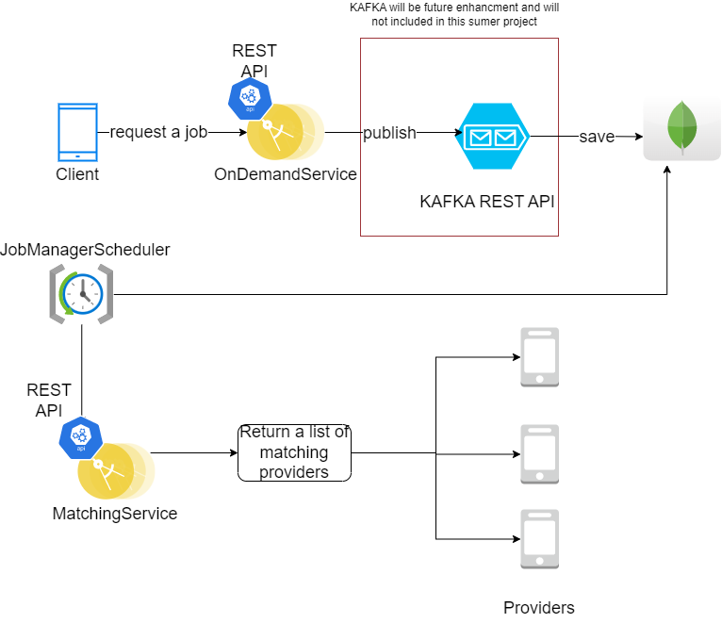
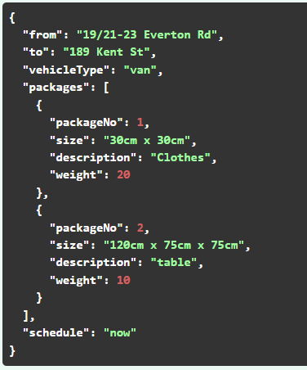
Customer Service API
Request a booking/job
Endpoint: /customers/[services]/request

Slide 10
CrowdService
Method name | HTTP METHOD | Endpoint | Description
matchProviders | POST | /crowd/providers/ | Retrieve a list of matching providers

Slide 11
Matching Service API
Endpoint: /disco/[services]/matching
Provider address (country->state -> city)
Job name
Matching attributes
Suppliers’ location within a 1km radius centered from the requested location
Vehicle type
Calculate the shipping cost
EST of delivery

Slide 12
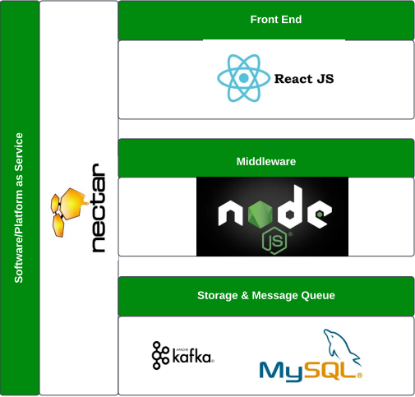
Tech Stack

Slide 13
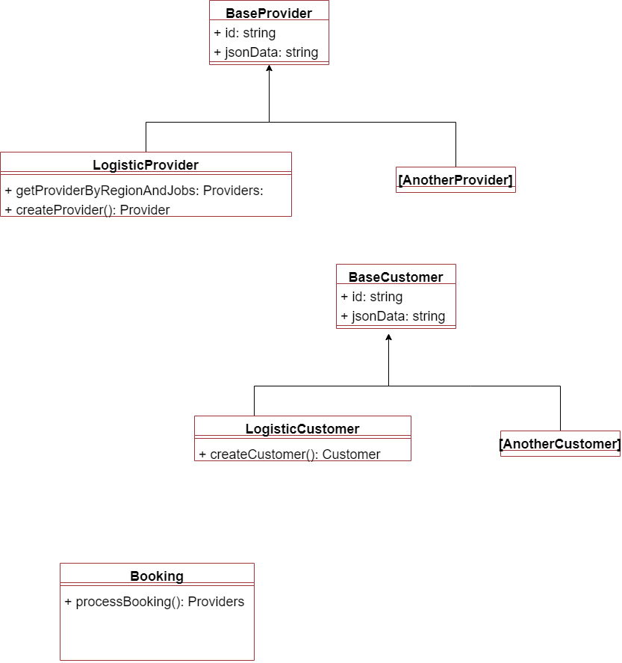
Class Diagram

Slide 14
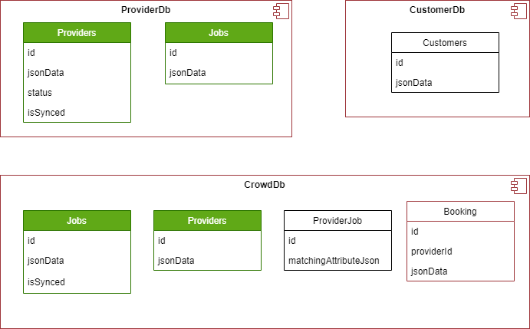
Database Design

Slide 15
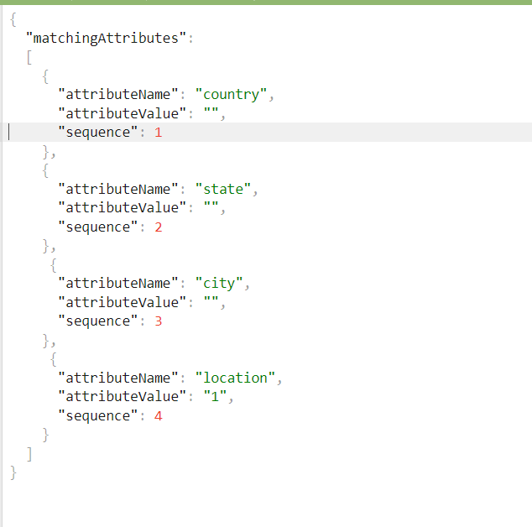
Example of how to provide matching attributes for a specific provider

Slide 16
Development Timeline
2022
2022
Today
Week 1
2
3
4
5

Slide 17
Development tools
No | Tools | Credentials | URL
1 | GitHub
2 | Necta

